Slide 1
12. Materials & Scattering
Dr. Hamish Carr & Dr. Rafael Kuffner dos Anjos

Slide 2
Agenda
Scattering Function
Surface Frame
BSDFs and their properties
Approximations
Different models

Slide 3
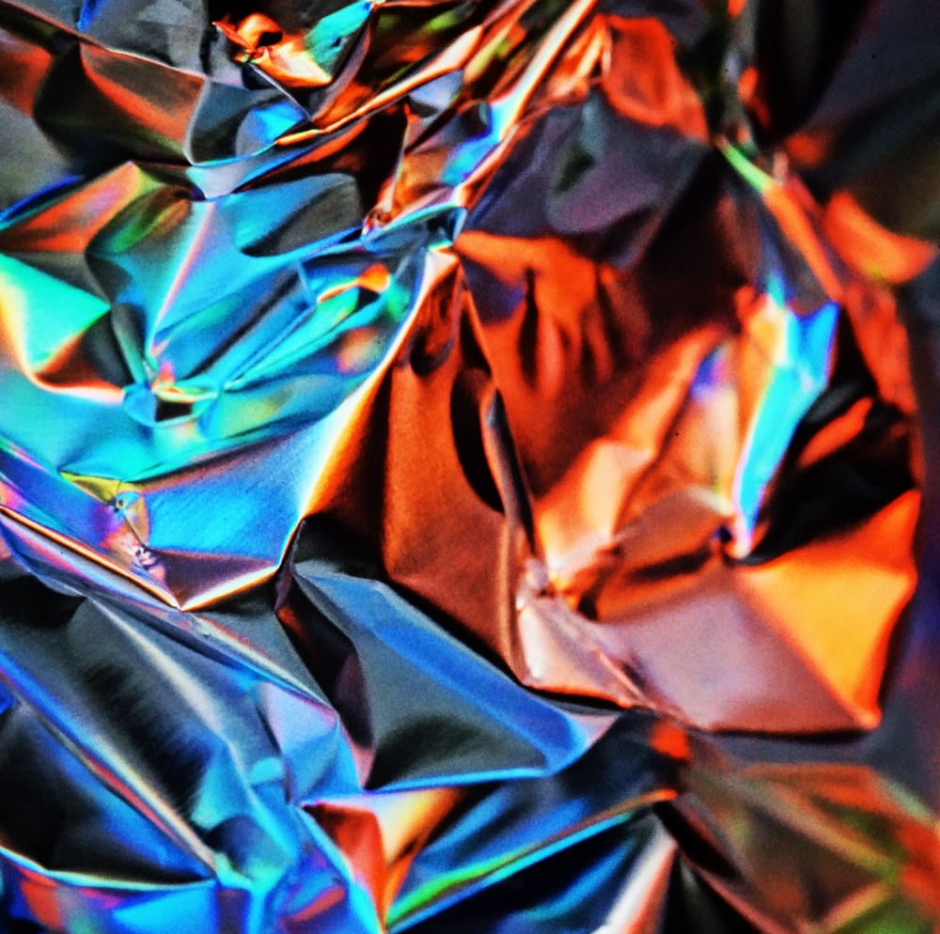

Material Models
We need to model large numbers of photons
So we want statistical behaviour, capturing:
Specular reflection
Glossy reflection
Lambertian (matte) reflection
Subsurface scattering
Transmission
All captured in a scattering function
COMP 5812M: Foundations of Modelling & Rendering

Slide 4
Scattering Functions
Textures
Bi-directional reflectance dist. func. (BRDF)
Bi-directional transmission dist. func. (BTDF)
Bi-directional scattering dist. func. (BSDF)
Bi-dir scattering & subsurface d.f. (BSSDF)
All of which share common features

Slide 5
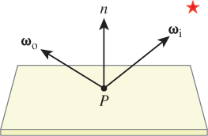
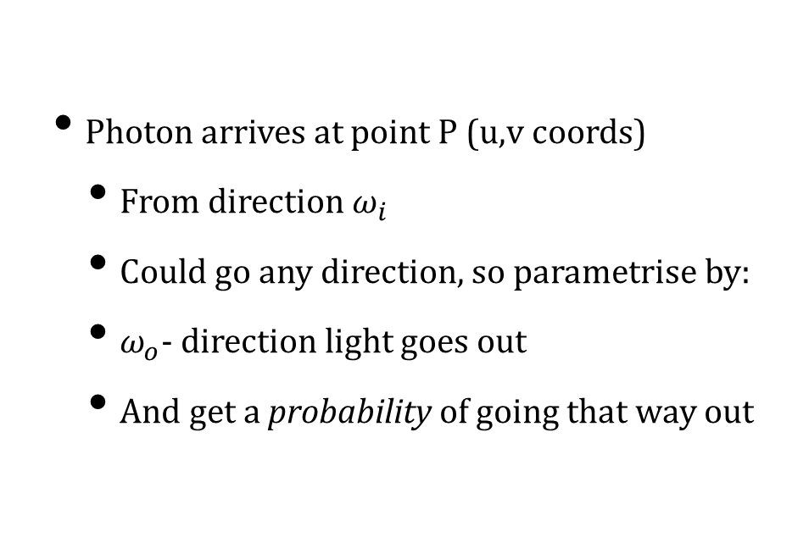
Scattering Functions
Photon arrives at point P (u,v coords)
From direction $ω_{i}$
Could go any direction, so parametrise by:
$ω_{o}$- direction light goes out
And get a probability of going that way out
COMP 5812M: Foundations of Modelling & Rendering

Slide 6
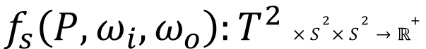
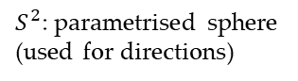
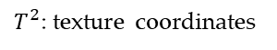
Mathematically
Note we have a 6-D function
2D – texture coords for point
2x2D – spherical coordinates for directions
$$f_{s}\left(P,ω_{i},ω_{o}\right):T^{2}{×S}^{2}×S^{2}→ℝ^{+}$$
$T^{2}$: texture coordinates
$S^{2}$: parametrised sphere
(used for directions)

Slide 7

How do we use this function?
We are using 2 coordinates (u,v) to locate our point
This does not give us the orientation we need for the scattering function
COMP 5812M: Foundations of Modelling & Rendering

Slide 8

Directions
Directions are assumed to be unit vectors
And can be parametrised to a sphere
Texture coordinates give:
Surface tangents
Surface normal
i.e. a local coordinate frame at P
So we can express it in these terms

Slide 9
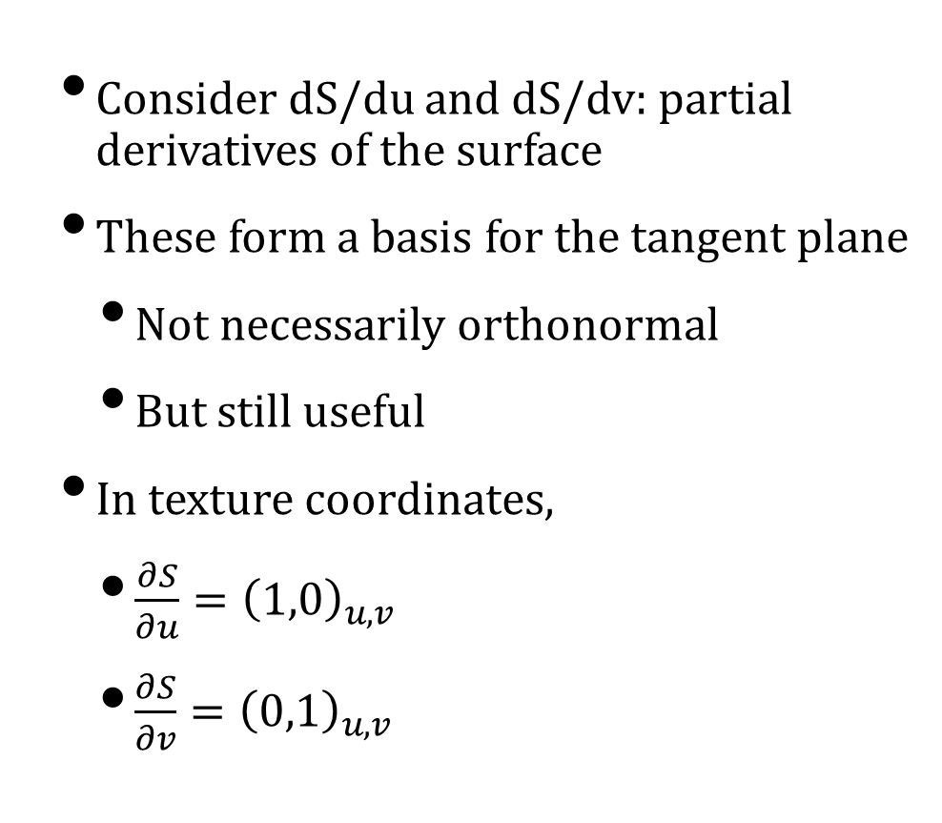
Finding the Surface Frame
Consider dS/du and dS/dv: partial derivatives of the surface
These form a basis for the tangent plane
Not necessarily orthonormal
But still useful
In texture coordinates,
$\frac{∂S}{∂u}={\left(1,0\right)}_{u,v}$
$\frac{∂S}{∂v}={\left(0,1\right)}_{u,v}$
COMP 5812M: Foundations of Modelling & Rendering

Slide 10

Computation
We assume that the normal vector is known
And take two edges $\vec{b},\vec{c}$ of a triangle $∆ABC$
We will compute them twice:
In spatial coordinates
In texture coordinates
Then use a matrix inverse to convert them
COMP 5812M: Foundations of Modelling & Rendering

Slide 11
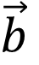
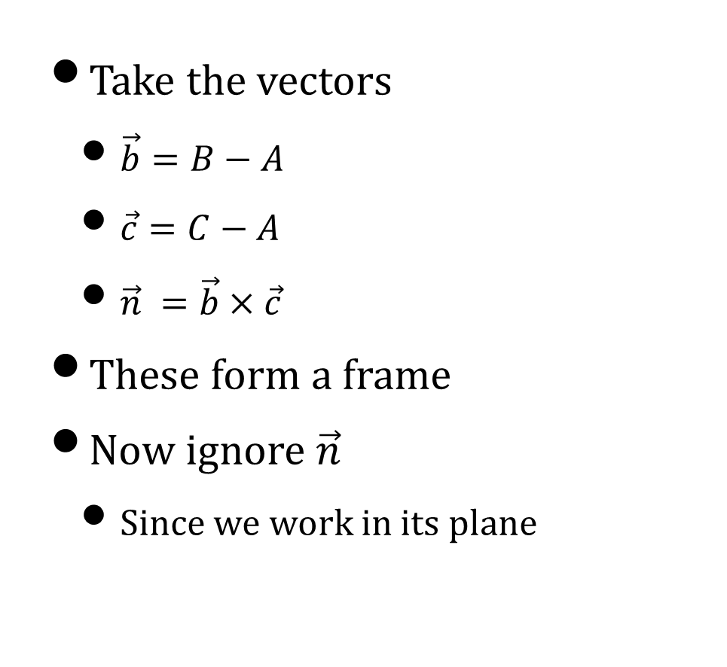
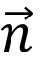

Spatial Frame
Take the vectors
$\vec{b}=B−A$
$\vec{c}=C−A$
$\vec{n} =\vec{b}×\vec{c}$
These form a frame
Now ignore $\vec{n}$
Since we work in its plane
$$\vec{n}$$
C
$$\vec{c}$$
A
$$\vec{b}$$
B

Slide 12
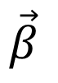
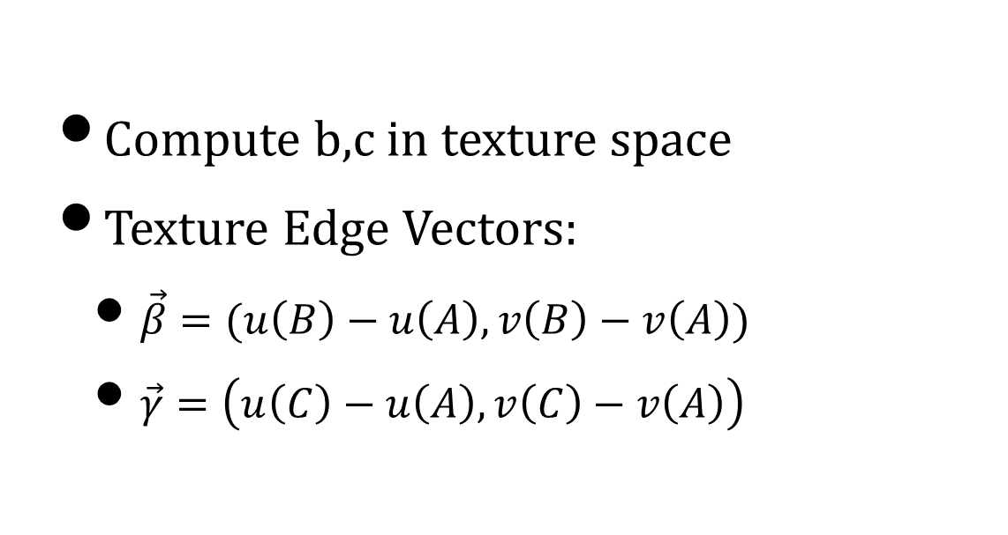
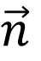
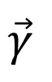
Texture Vectors
Compute b,c in texture space
Texture Edge Vectors:
$\vec{β}=(u\left(B\right)−u\left(A\right), v\left(B\right)−v\left(A\right))$
$\vec{γ}=\left(u\left(C\right)−u\left(A\right), v\left(C\right)−v\left(A\right)\right)$
$$\vec{n}$$
C
$$\vec{γ}$$
A
$$\vec{β}$$
B

Slide 13
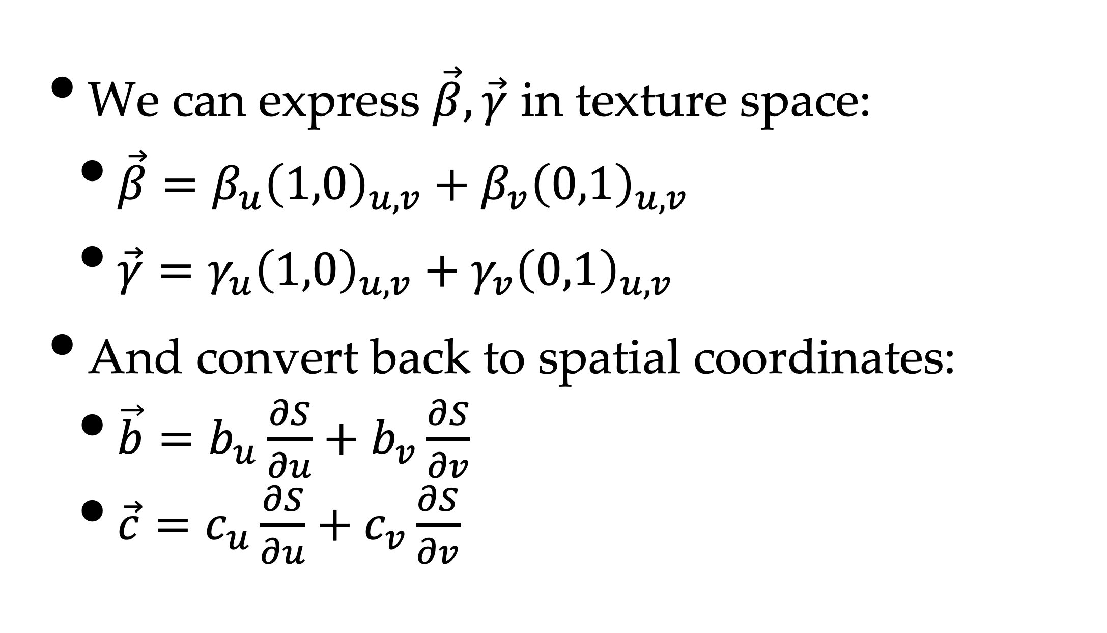
Setting Up Equations
We can express $\vec{β}, \vec{γ}$ in texture space:
$\vec{β}=β_{u}{\left(1,0\right)}_{u,v}+β_{v}{\left(0,1\right)}_{u,v}$
$\vec{γ}=γ_{u}{\left(1,0\right)}_{u,v}+γ_{v}{\left(0,1\right)}_{u,v}$
And convert back to spatial coordinates:
$\vec{b}=b_{u}\frac{∂S}{∂u}+b_{v}\frac{∂S}{∂v}$
$\vec{c}=c_{u}\frac{∂S}{∂u}+c_{v}\frac{∂S}{∂v}$

Slide 14
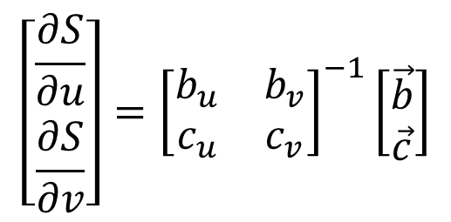
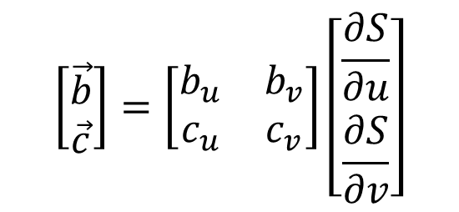
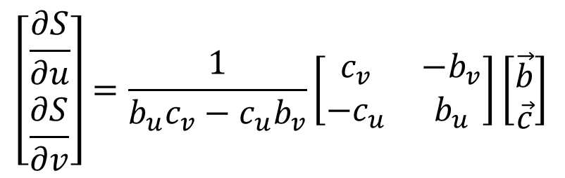
Matrix Form
$$\left[\begin{matrix}\vec{b} \\ \vec{c}\end{matrix}\right]=\left[\begin{matrix}b_{u} & b_{v} \\ c_{u} & c_{v}\end{matrix}\right]\left[\begin{matrix}\frac{∂S}{∂u} \\ \frac{∂S}{∂v}\end{matrix}\right]$$
$$\left[\begin{matrix}\frac{∂S}{∂u} \\ \frac{∂S}{∂v}\end{matrix}\right]={\left[\begin{matrix}b_{u} & b_{v} \\ c_{u} & c_{v}\end{matrix}\right]}^{−1}\left[\begin{matrix}\vec{b} \\ \vec{c}\end{matrix}\right]$$
$$\left[\begin{matrix}\frac{∂S}{∂u} \\ \frac{∂S}{∂v}\end{matrix}\right]=\frac{1}{b_{u}c_{v}−c_{u}b_{v}}\left[\begin{matrix}c_{v} & −b_{v} \\ {−c}_{u} & b_{u}\end{matrix}\right]\left[\begin{matrix}\vec{b} \\ \vec{c}\end{matrix}\right]$$

Slide 15

Problem
How do we use our function ?
Storing 6D functions is impractical
32 samples / parameter gives 2³⁰ ~ 1 GB data
$$f_{s}\left(P,ω_{i},ω_{o}\right):T^{2}{×S}^{2}×S^{2}→ℝ^{+}$$
COMP 5812M: Foundations of Modelling & Rendering

Slide 16

Solution?
So in practice, we never actually use them
Instead we use Euclidean products of:
BSDF variation in one texture
Local basis in a second texture
Another texture if needed for orientation
COMP 5812M: Foundations of Modelling & Rendering

Slide 17
Sources of BSDFs
Measured (expensive, noisy):
Build a measuring device, store GBs of data
Analytic (clean, expressive):
Build a mathematical model (how?)
Artistic (cheap(er), acceptable):
Pay an artist to paint it
Requires training your artist in BSDFs

Slide 18
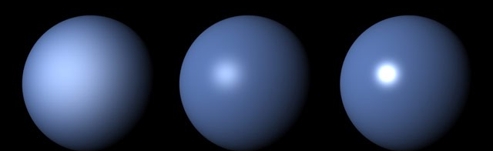
Blinn-Phong Shading
Just one way to do a BSDF:
No specular (mirrored reflections)
Gloss (called specular)
Diffuse (Lambertian)
No subsurface scattering
Ambient (substitutes for light transport)
Emissive

Slide 19
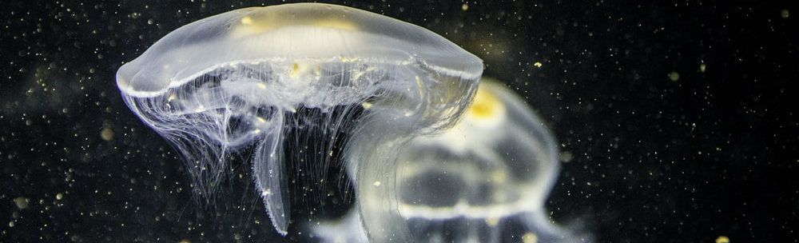
Translucency
Translucency is transmitted light
May be in addition to reflected light
Green glass transmits green, reflects darker
High-quality rendering does refraction
Other rendering does blending (compositing)
Combines light from behind with material
And causes problems if not ray-tracing

Slide 20
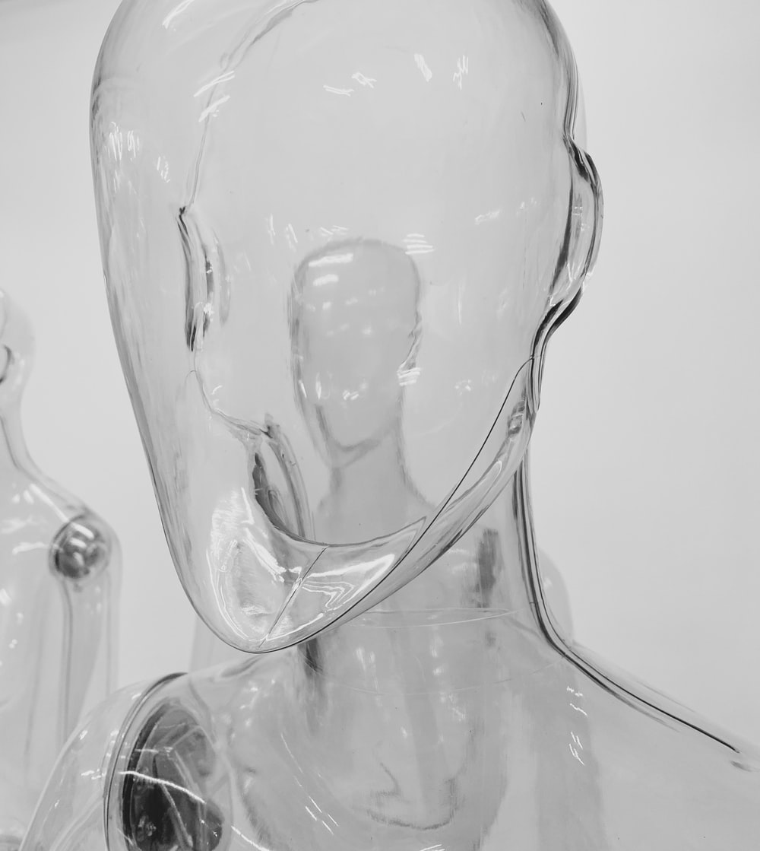
Alpha Opacity
Translucency is modelled by alpha
The percentage of (R,G,B) transmitted
Stored as an extra channel in a buffer/image
Often stored premultiplied
Can be stored in a texture
E.g. stained glass window
COMP 5812M: Foundations of Modelling & Rendering

Slide 21
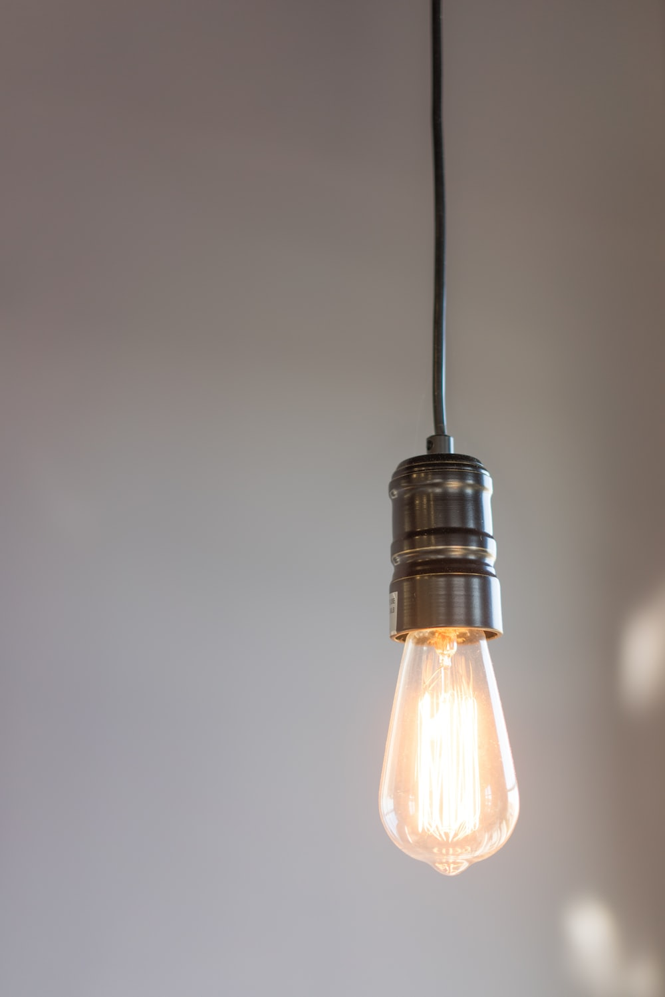
Emission
Surfaces may emit light
In ray-tracing, these are luminaires
The rest of the time, they are an extra term
And are crucial for inter-object lighting
Lights in-scene, torches, gun blast
Can be handled with extra textures
Light maps instead of lighting
COMP 5812M: Foundations of Modelling & Rendering

Slide 22

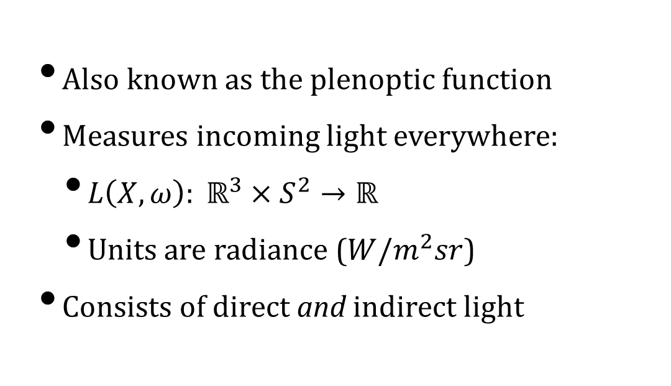
Radiance Function
Also known as the plenoptic function
Measures incoming light everywhere:
$L\left(X,ω\right): ℝ^{3}×S^{2}→ℝ$
Units are radiance ($W/m^{2}sr$)
Consists of direct and indirect light
COMP 5812M: Foundations of Modelling & Rendering

Slide 23
Ground Truth
We don’t have an ideal solution
We have lots of approximations
So this is very much a matter of choice
Which effects you want to represent
How realistic they look (the eyeball test)
And this is not likely to change soon

Slide 24
Approaches
Empirical / phenomenological
Constructed to “look right”
Measured
Physically expensive to measure
Huge storage requirements
Limited creative control
Physically based
Mathematical analysis of physics

Slide 25
Physical Constraints
Energy Conservation
Reciprocity
Surface vs. Subsurface
Volumetric Representations
Material Scale
Specular Representation

Slide 26
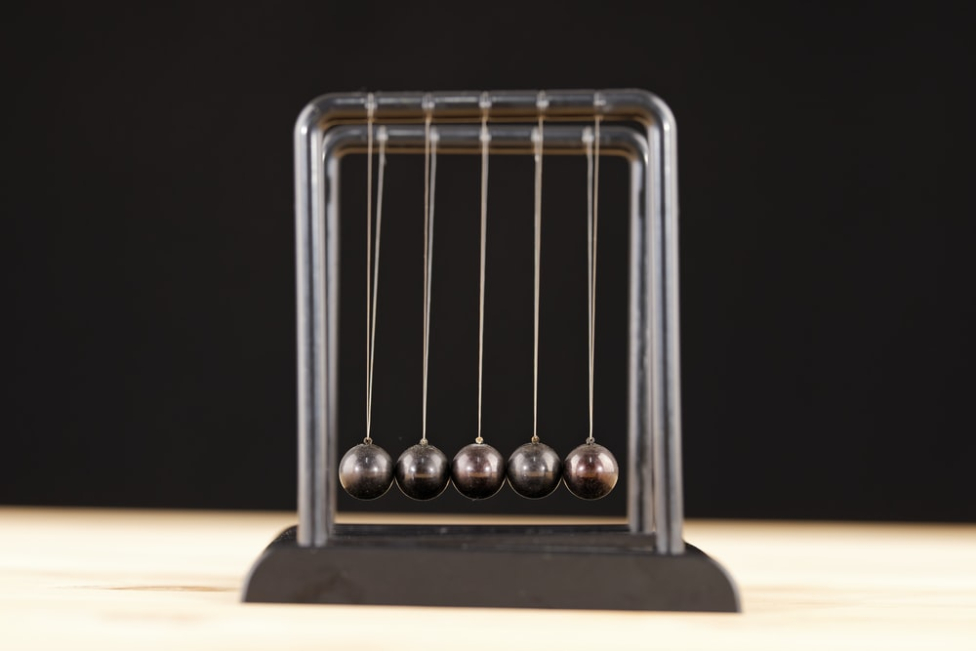
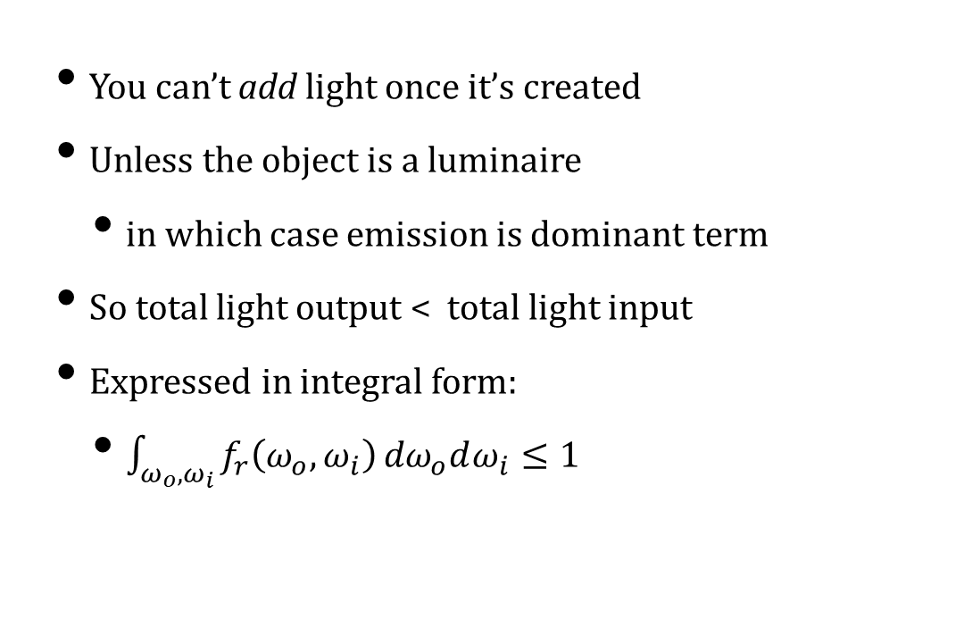
Energy Conservation
You can’t add light once it’s created
Unless the object is a luminaire
in which case emission is dominant term
So total light output < total light input
Expressed in integral form:
$\int_{ω_{o},ω_{i}}^{ }{f_{r}\left(ω_{o},ω_{i}\right)}{dω}_{o}dω_{i}≤1$
COMP 5812M: Foundations of Modelling & Rendering

Slide 27
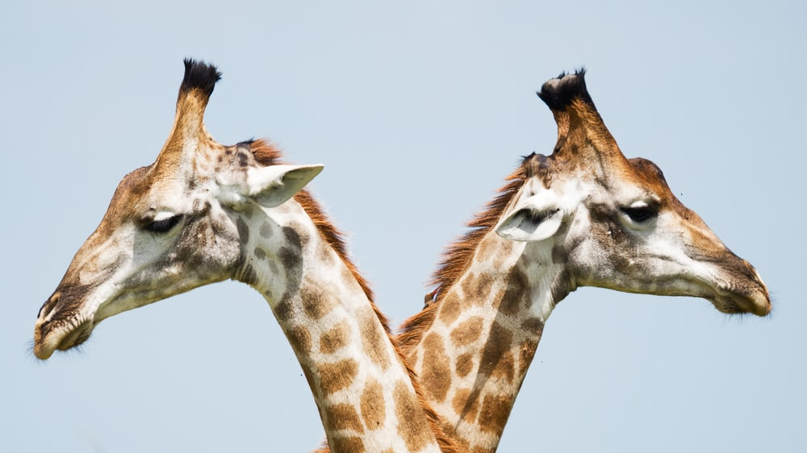

Reciprocity
Scattering is (almost always) symmetric
The reverse reflection is identical
$f_{r}\left(ω_{o},ω_{i}\right)=f_{r}\left(ω_{i},ω_{o}\right)$
Generalises to transmission as well
$\frac{f_{s}\left(ω_{i},ω_{o}\right)}{n_{o}^{2}}=\frac{f_{s}\left(ω_{o},ω_{i}\right)}{n_{i}^{2}}$
Often called Helmholtz Reciprocity
COMP 5812M: Foundations of Modelling & Rendering

Slide 28
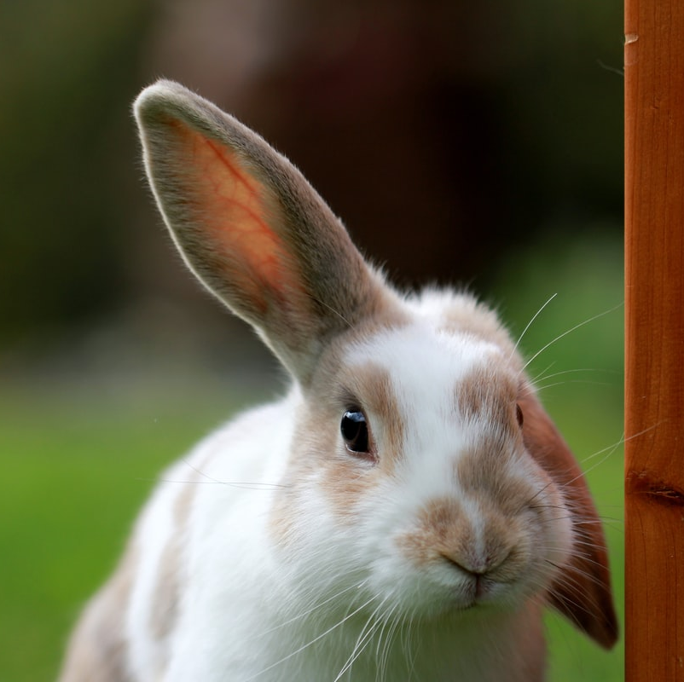
Surface vs. Subsurface
Subsurface scattering may travel
i.e. light emerges somewhere else
This complicates matters
but for now we’ll skip that
COMP 5812M: Foundations of Modelling & Rendering

Slide 29
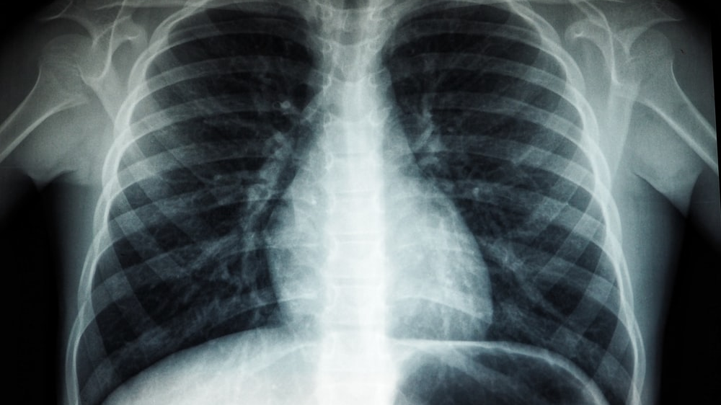
Volumetric Representation
This all still assumes that we have surfaces
We might have volumetric effects
Complex interactions in a volume of space
These are an entirely different question
Heavily used in science & medicine
Typically a different code path
We’ll come back to this
COMP 5812M: Foundations of Modelling & Rendering

Slide 30
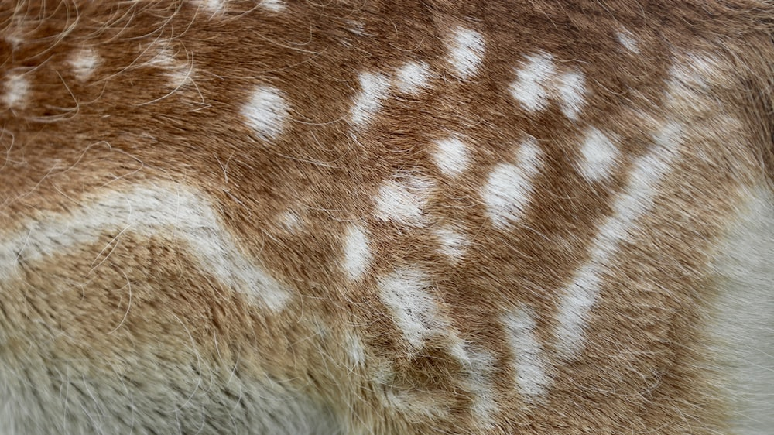
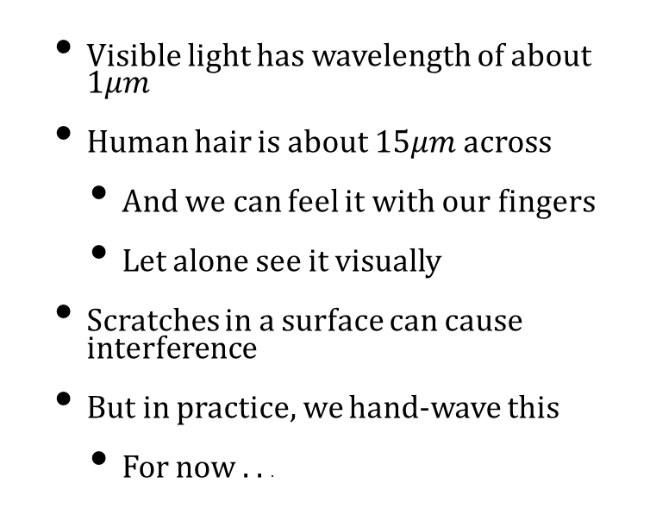
Material Scale
Visible light has wavelength of about 1$μm$
Human hair is about 15$μm$ across
And we can feel it with our fingers
Let alone see it visually
Scratches in a surface can cause interference
But in practice, we hand-wave this
For now . . .
COMP 5812M: Foundations of Modelling & Rendering

Slide 31
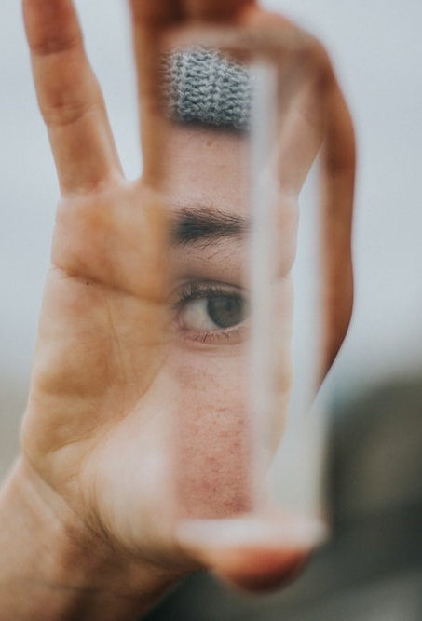
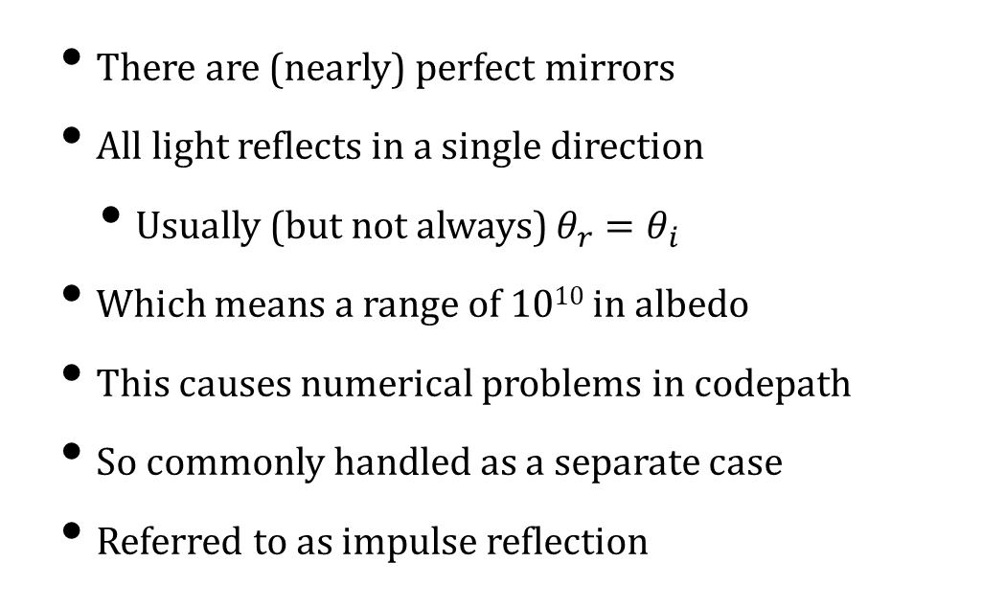
Specular Reflection
There are (nearly) perfect mirrors
All light reflects in a single direction
Usually (but not always) $θ_{r}=θ_{i}$
Which means a range of 10¹⁰ in albedo
This causes numerical problems in codepath
So commonly handled as a separate case
Referred to as impulse reflection
COMP 5812M: Foundations of Modelling & Rendering

Slide 32
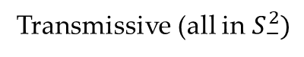
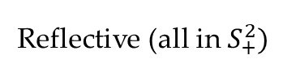
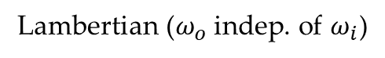
Scattering Phenomena
Reflective (all in $S_{+}^{2})$
Transmissive (all in $S_{−}^{2})$
Mirror (Impulse)
Retroreflective
Refractive
&c.
Glossy (Blurred Mirror)
Lambertian ($ω_{o}$ indep. of $ω_{i}$)

Slide 33
Plotting the BSDF
Consider light with respect to surface frame
We can plot the distribution of reflection
Radiance or probability density function (pdf)
BSDF
COMP 5812M: Foundations of Modelling & Rendering

Slide 34
Radiance vs. PDF
Radiance is a physical quantity
pdf is integrated
Over a small patch
Uses cosines like “diffuse” reflection
Carries forward through our integration
Because samples are actually integrals
COMP 5812M: Foundations of Modelling & Rendering

Slide 35
Examples of Scattering
Radiance
PDF

Slide 36
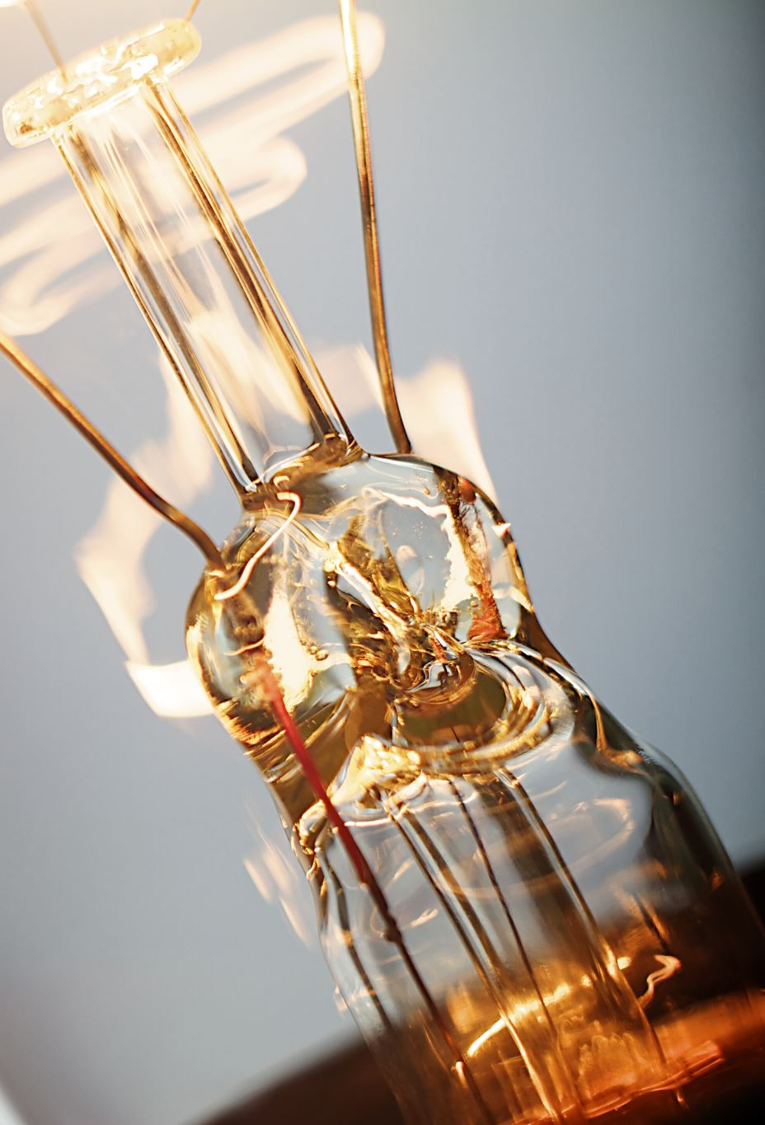
Mirror “Scattering”
Mirrors do absorb light
But reflect most of it
Insulators preserve spectral distribution
Conductors have “preferred” frequencies
So typically stored as RGB albedo
This ignores polarisation
We’ll see geometric hacks next term
COMP 5812M: Foundations of Modelling & Rendering

Slide 37
Lambertian vs. Phong
Lambertian ~ Phong diffuse
Effectively captured in ⍴ term
But cosine term needed for pdf
Based on dot product
Which explains success of Phong model
it’s close to the truth

Slide 38

Lafortune Model
Measured BRDFs are not centred
i.e. the angle of reflection is off
So they generalised by adding more terms
Multiple specular lobes
With different properties
COMP 5812M: Foundations of Modelling & Rendering

Slide 39
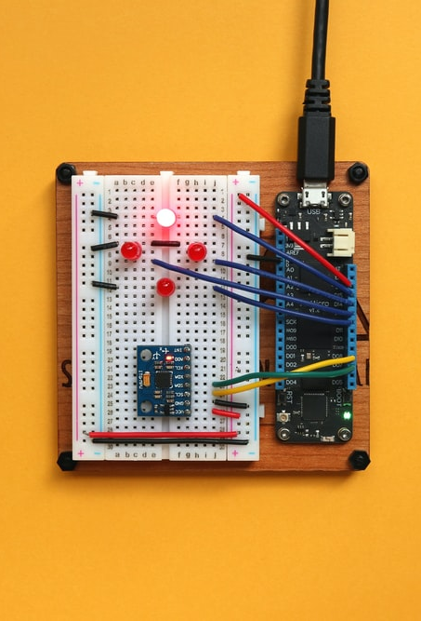
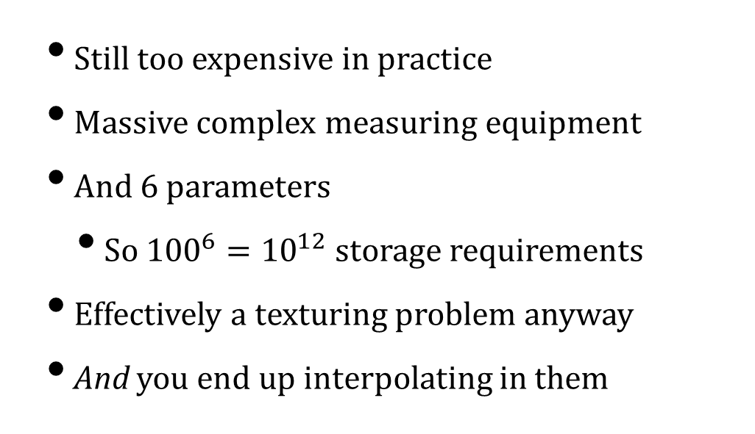
Measured BRDFs
Still too expensive in practice
Massive complex measuring equipment
And 6 parameters
So ${100}^{6}={10}^{12}$ storage requirements
Effectively a texturing problem anyway
And you end up interpolating in them
COMP 5812M: Foundations of Modelling & Rendering

Slide 40
Torrance-Sparrow Model
Light actually reflects from microfacets
These occlude each other
So the BRDF isn’t quite what you expect
COMP 5812M: Foundations of Modelling & Rendering

Slide 41
Cook-Torrance Model
Diffuse reflection is subsurface
Specular reflection is surface
Extra terms in the equation
COMP 5812M: Foundations of Modelling & Rendering

Slide 42
Oren-Nayar Model
Micro-roughness near the silhouette
Causes extra reflection towards viewer
Extra lightness near boundaries

Slide 43
Subsurface Scattering
Light goes in at P, emerges at Q
After complex interactions & bounces
Even the textbooks say this is too complex
There are ways to approximate it (next term)

Slide 44
The Practical Reality
People still use Phong lighting for real-time
And they add various tricks to improve it
Per-pixel shading
Texture-based material storage
Geometric hacks (next term)
Where it falls down is global illumination
The ”ambient” term
COMP 5812M: Foundations of Modelling & Rendering

Slide 45
Images by
S3 Vinicius “amnx” Amano
S7 Nick Fewings
S19 Matthias Gotzke
S20 Anh Tuan To
S21 Engin Akyurt
S22 Vincent Van Zalinge
S30 Julianne Liebermann
S31 Vince Fleming
S39 Jorge Ramirez

